Slide 1

High availability related techniques

Slide 2

Clustering for high availability
HA Techniques
Redundancy
Time – retransmit
Data – e.g. parity bits
Processing – e.g. redundant nodes
Diversity
e.g. Hybrid deployments, do the same thing using different implementations
HA deciding factors
Average throughput (TPS)
Max throughput (TPS)
Monetary value of a transaction
Average loss & max loss per second of downtime
Decide on how much to invest on availability based on cost vs. benefit tradeoff

Slide 3
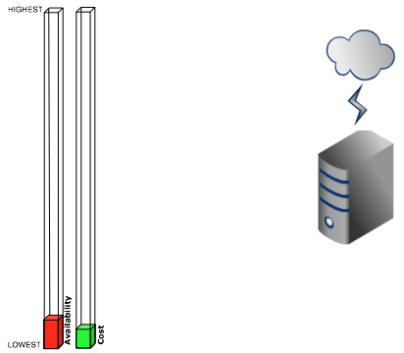
Single node

Slide 4
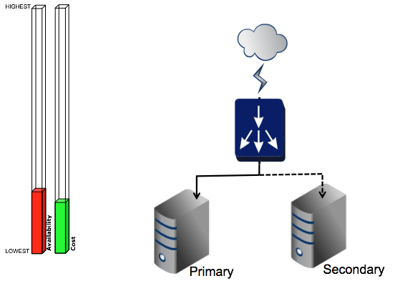
Primary - Secondary

Slide 5
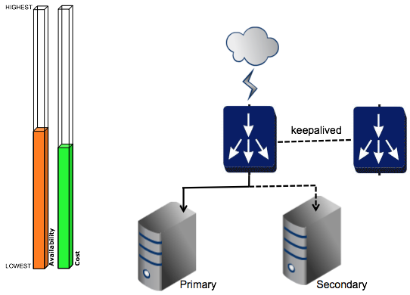
Primary - Secondary / Multiple LB

Slide 6
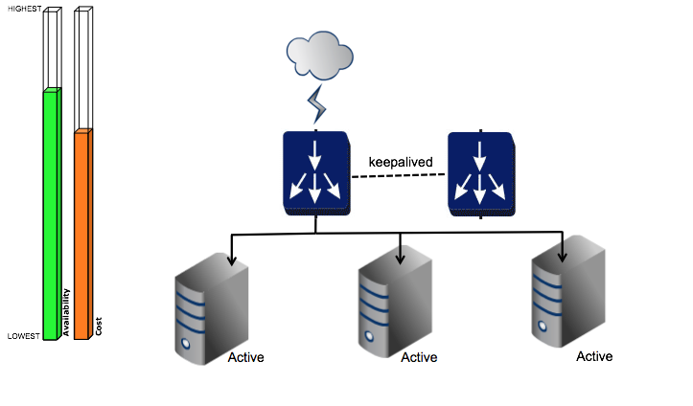
Active Cluster / Multiple LB

Slide 7
Worker-Manager Separation
Proper separation of concerns - management nodes specialize in management of the setup while worker nodes specialize in serving requests to deployment artifacts
Only management nodes are authorized to add new artifacts into the system or make configuration changes
Worker nodes can only deploy artifacts & read configuration
Lower memory footprint in the worker nodes because the management console related OSGi bundles are not loaded
Improved security - management nodes can be behind the internal firewall & be exposed to clients running within the organization only, while worker nodes can be exposed to external clients
Isolation of failures

Slide 8
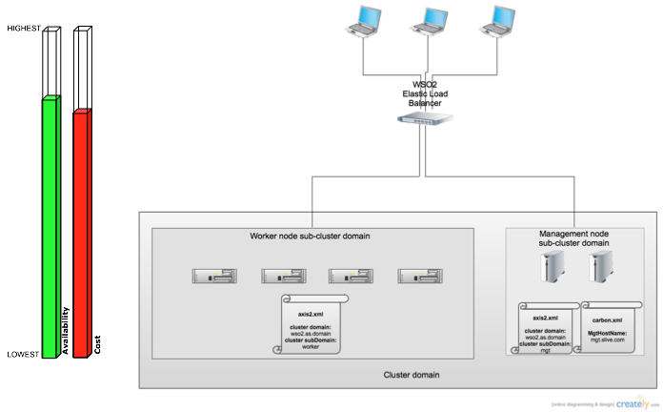
Worker-Manager Separation

Slide 9
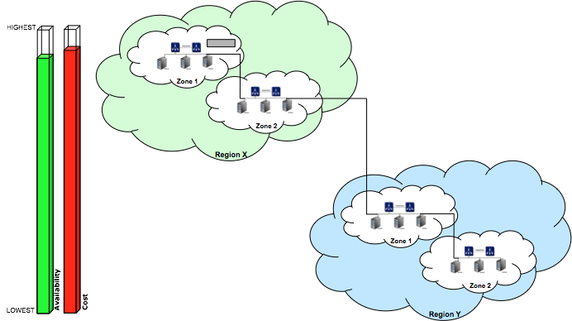
Multi Zone and Multi Region Deployment

Slide 10
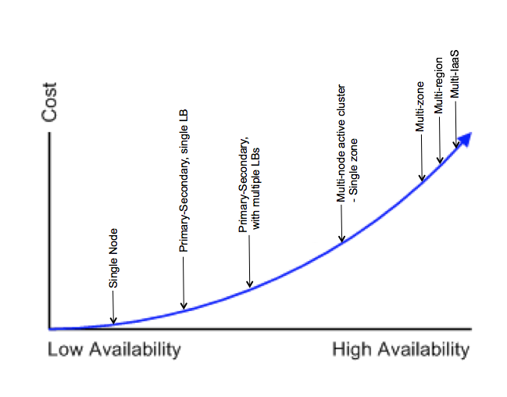
Cost of availability

Slide 11
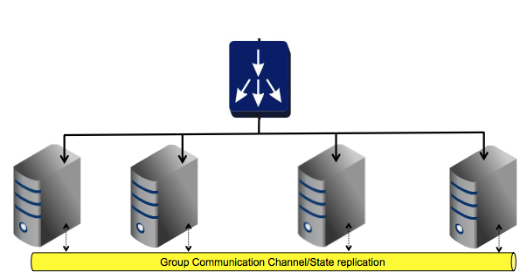
Clustering For Scalability

Slide 12
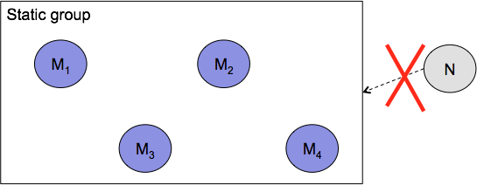
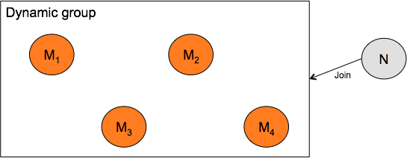
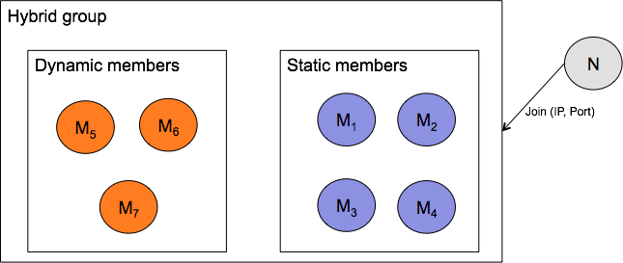
WSO2 Product Clustering Details
Three type of memberships - Static / Dynamic / Hybrid

Slide 13
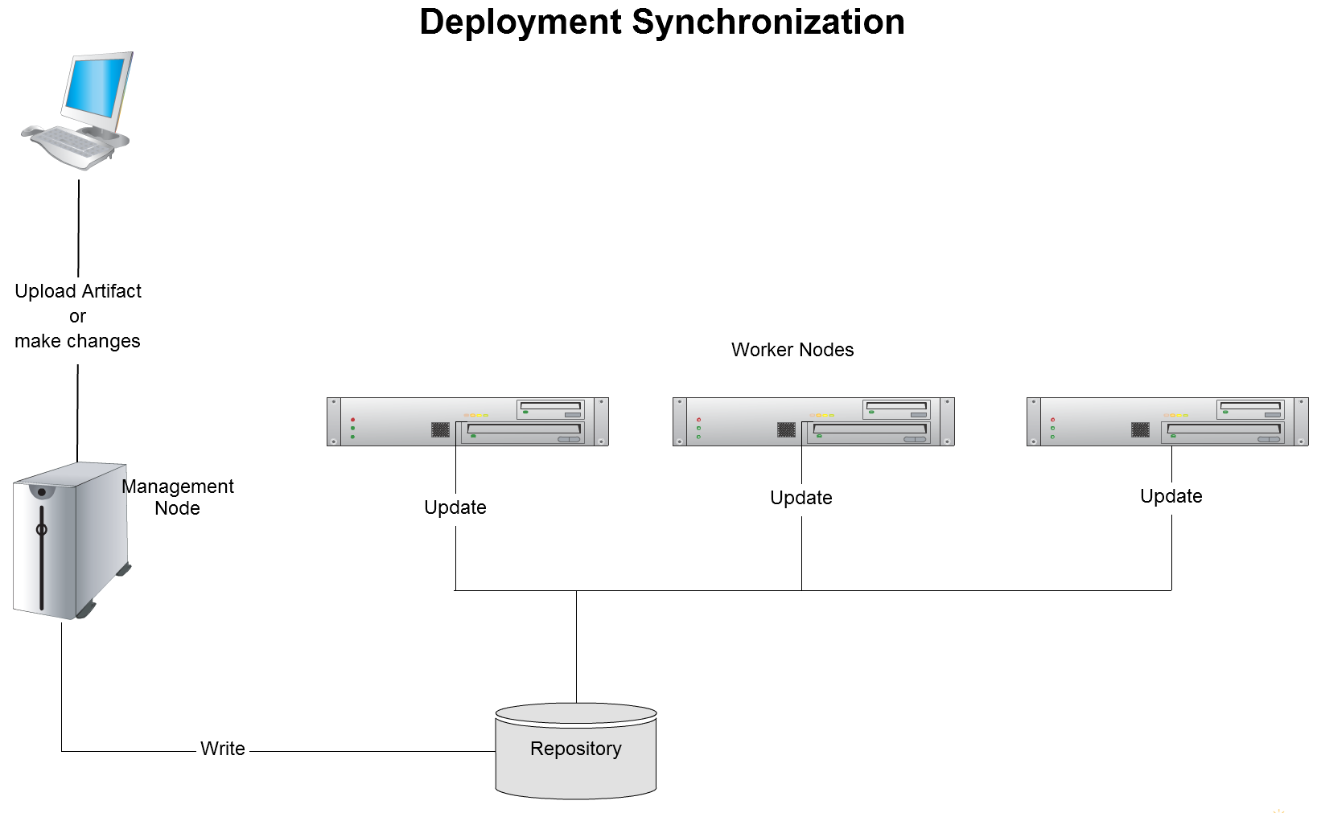
Deployment Synchronization Model

